Slide 1
SACSCOC team members change at the last minute

Slide 2
Welcoming the SACSCOC Evaluation Committee in your underwear…..

Slide 3
Administrative changes occur at the college just prior to the SACSCOC team arriving on campus

Slide 4
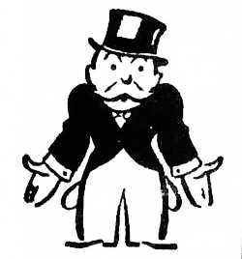
The rooms booked months prior had been given to someone else.

Slide 5
A least one member of the team does not read material sent to them by the college. They literally walk in the door demanding documents.

Slide 6
Miscommunication about technology needs

Slide 7
Interviewees no-show

